Slide 1
Data Pipeline for Environmental Noise Contamination Detector
Todd Schultz, Sean Miller, Rahul Birmiwal
28 Nov 2018

Slide 2
Outline
Problem statement
Available data
Issues
Preliminary insight
Feature set options

Slide 3
Problem statement
Aircraft certification requires flyover noise measurement
Environmental noise contamination is costly
Adds time to repeat required conditions
Potential to fail certification
Source include
Bird chirps
Wildlife/livestock vocalizations
Traffic noise
Use 3 engineers for monitoring

Slide 4
Proposal
Create an automated environmental contamination detector based on acoustic signals
Feasibility study
What’s the potential?
Roughly best feature set
Roughly best algorithm

Slide 5
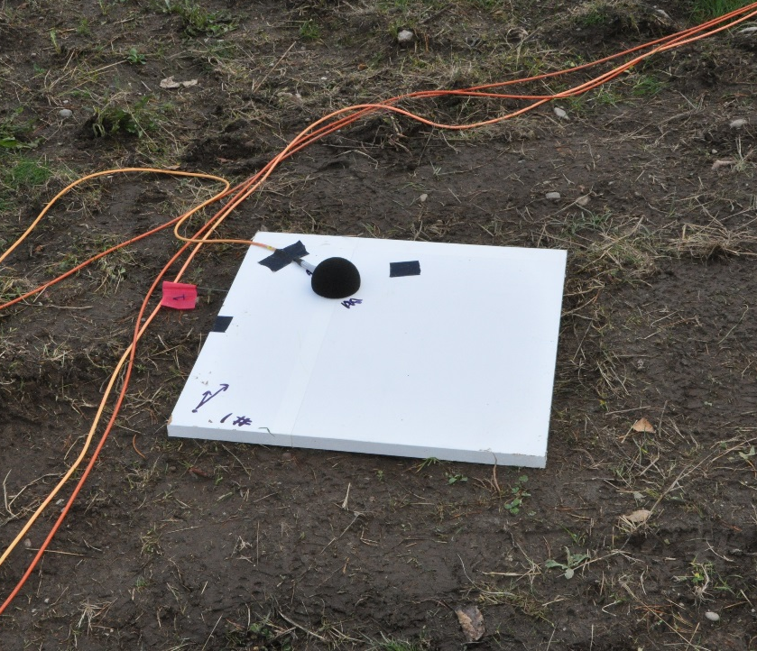
Available data
67 professional recorded and labeled wave files
Totally over 500 MC
Includes aircraft noise, wildlife noise, and ambient
Pressure amplitudes have been normalized for public release
Microphone installation

Slide 6

Available data
Bird chirp (bird01.wav)
Jet aircraft (plane8.wav)

Slide 7
Issues
Imbalance between classes
More clean aircraft signatures than contaminated
Public domain recordings for wildlife vocalizations exist
Superposition to create new, contaminated signal
Can use to test performance versus signal-to-noise ratio
Data management
Each signal will produce 50-100 blocks of features
Each block of features maybe 10-1,000’s of features

Slide 8
Preliminary insights
Bird chirp (bird01.wav)
Jet aircraft (plane8.wav)

Slide 9
Preliminary insight
Start simple, build up experience
Spectra are expected to be different
plane8.wav, jet aircraft

Slide 10
Feature set options
Numerous options available for feature generation
(1/n) Octave band spectrum
Cepstrum
Short-time Fourier Transform
Wavelets

